Slide 1
Union Airways Example
題目：UNION AIRWAYS is adding more flights to and from its hub airport, and so it needs to hire additional customer service agents. Based on the new schedule of flights,….. the provision is that each agent work an 8-hour shift 5 days per week, and authorized shifts are……
Shift 1：6:00 A.M. to 2:00 P.M.
Shift 2：8:00 A.M. to 4:00 P.M.
Shift 3：Noon. to 8:00 P.M.
Shift 4：4:00 P.M. to midnight.
Shift 5：10:00 P.M. to 6:00 A.M.

Slide 2
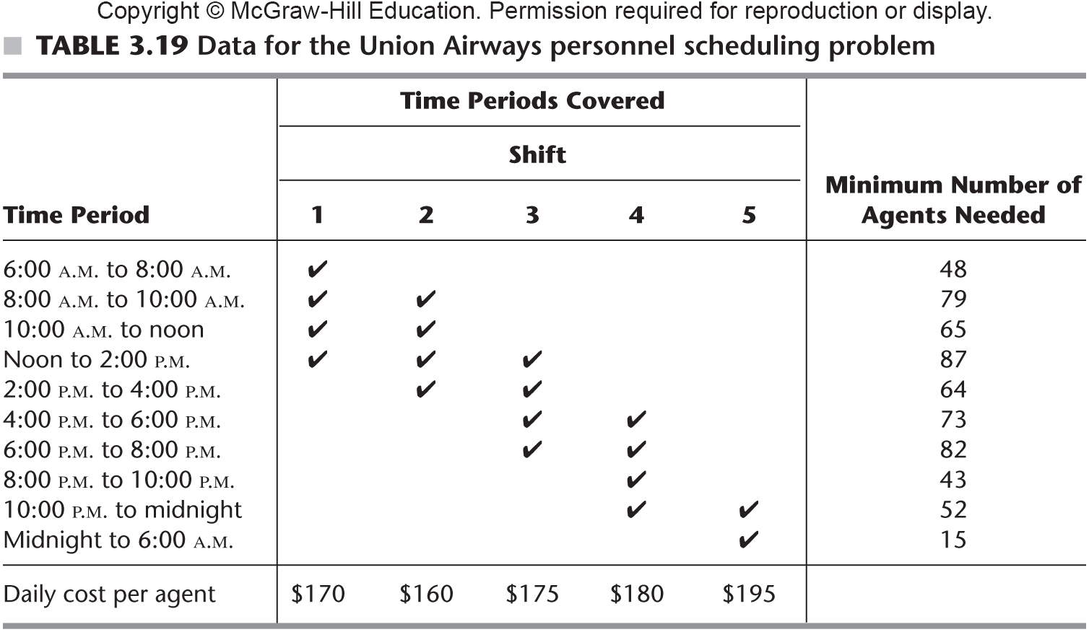
Union Airways Example

